Slide 1


The Art of Agile Product Documentation
with David Sabine
Notes:
2:45pm

Slide 2

DAVID SABINE
Notes:
2:48pm

Slide 3
WELCOME
A sense-making workshop to simplify valuable documentation & reduce wasteful documentation.
<aside> Hats off to James Shore and Shane Warden. </aside>
Notes:
2:50pm

Slide 4
PURPOSE
Reframe our understanding of documentation vis a vis complex/adaptive work.
Reframe our understanding of ‘implementation’ — when does it occur?
Appraise commonly-used documents with respect to customer-recognizable value.
Simplification. Excellence.
Notes:
2:52pm

Slide 5
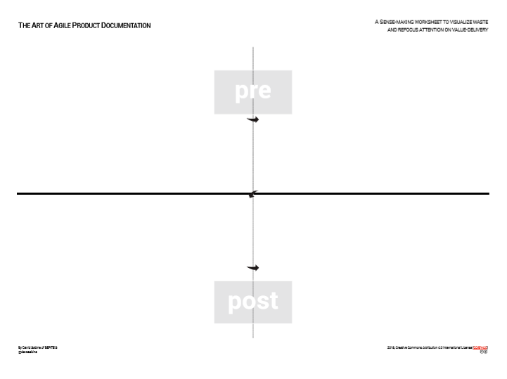
1.
DOCUMENTS, DOCUMENTS, DOCUMENTS.
{~5 minutes}
USER STORY
SCREEN COMPOSITE
Notes:
2:53pm
One idea per sticky.
5 minutes: write the names of as many documents as you can think of.
Write privately & quietly at first. (This will speed things up.) No filtering, no judgement, just make visible as many different documents that come to mind. After the most obvious items, discuss and help each other think of more.
Place the stickies anywhere on the canvas.
FOR THOSE who don’t have a canvas at their table, use a large flipchart paper please and I’ll help you ‘create’ the canvas as we move on through the workshop.
List all documents which come to mind.
GO
Examples: BRD, Project Plan, UI design, test plan, tech spec, Statement of Work.
Internal documents. Client-facing documents. ‘Between-team’ documents. Short-lived documents. Long-lived archives.
Less obvious: Email, chat messages, contracts, flow diagrams, time sheets, audit evidence, compliance measures, test results, experiments, prototypes, source code, MSA, payment receipts.

Slide 6
EXAMPLES & CONFIRM
Contract
Requirement
Artboard
Test plan
Test result
Source code
Usage guide
Installation guide
Notes:
2:57pm

Slide 7
2.
THE ‘POINT OF IMPLEMENTATION’
The ‘Point of Implementation’ is the point in time that a new behaviour, feature, requirement, element is codified into the product.
Notes:
3:02pm

Slide 8
IF IMPLEMENTING A NEW FEATURE
The Point of Implementation occurs when the source code is being altered to produce the new behaviour.
The new feature is said to have been “implemented” when the Product Developer or user can execute the new feature.
Notes:
3:04pm

Slide 9
IF IMPLEMENTING A NEW UI ELEMENT
The Point of Implementation occurs when the user interface is being altered to display the new design.
Notes:
3:05pm

Slide 10
IF FIXING A BUG
The Point of Implementation occurs when the source code is being adjusted to correct the undesirable behaviour.
Notes:
3:05pm

Slide 11

PRODUCT DEVELOPMENT IS ALWAYS…
A series of adjustments.
A series of implementations as each new behaviour is put into effect.
Notes:
3:06pm
In practical terms, a Point of Implementation occurs every time a Product Developer commits new lines of source code into their code repository.

Slide 12
IMPLEMENTATION IS NOT
Large Batch Analysis
Implementation “Phase”
“Launch”
Notes:
3:08pm

Slide 13
CLEAR?
Notes:
3:09pm

Slide 14

3.
AFFINITY MAPPING
{~4 minutes}
pre
post
Notes:
3:10pm

Slide 15
EXAMPLES & CONFIRM
REQUIREMENT
TEST PLAN
ART BOARD
CONTRACT
SOURCE CODE
USAGE GUIDE
TEST RESULT
INSTALLATION GUIDE
Notes:
3:16pm

Slide 16
4.
CONCEPT: PRE
Documents which inform decisions leading up to a Point of Implementation are kept:
Lightweight
Disposable
‘spec’ document
‘speculation’ document
Notes:
3:19pm
Documents may be informative (at best) but do not represent decision.
Until the Point of Implementation, all dialogue about said feature is conjecture.
Hypothesis. (tested with actual users only after implementation)

Slide 17
CONCEPT: POST
Documents which record the condition of the Product at a Point of Implementation are kept:
Version-controlled with the Increment
User-centric/audience-specific
Notes:
3:22pm
When we implement, a decision is codified — all information and dialogue to that point in time is captured and realized in the implementation.
The implementation is therefore a record of a set of decisions.
We want the ability to mark said decision-set as distinct from other sets — both in time and proximity. We also want the ability to undo the implementation with ease. Thus, version-controlling each increment of Product enables us to implement our decisions in small, reversible steps.
As well, we can remember our highest priority is to satisfy the customer through early and continuous delivery of valuable increments. Therefore, our implementation of any adjustment to the Product and its related artifacts must satisfy its users.
Who is the code for?
Who is the UI for?
Who is the audit evidence for?

Slide 18
5.
Planning Docs
Lightweight
Disposable
Implementation In-progress Docs
Lightweight
Disposable
QUADRANTS
“Done” Potentially Releasable Docs
Version-controlled with the Increment
User-centric/Audience-specific
Hand-off Docs
Version-controlled with the Increment
User-centric/Audience-specific
Notes:
3:25pm
Table-groups will discuss ways to radically simplify and/or automate the documents listed on their canvas. And for each, if the quality expectations described in Segment 4 cannot be achieved, the document will be removed from the canvas and discarded.

Slide 19
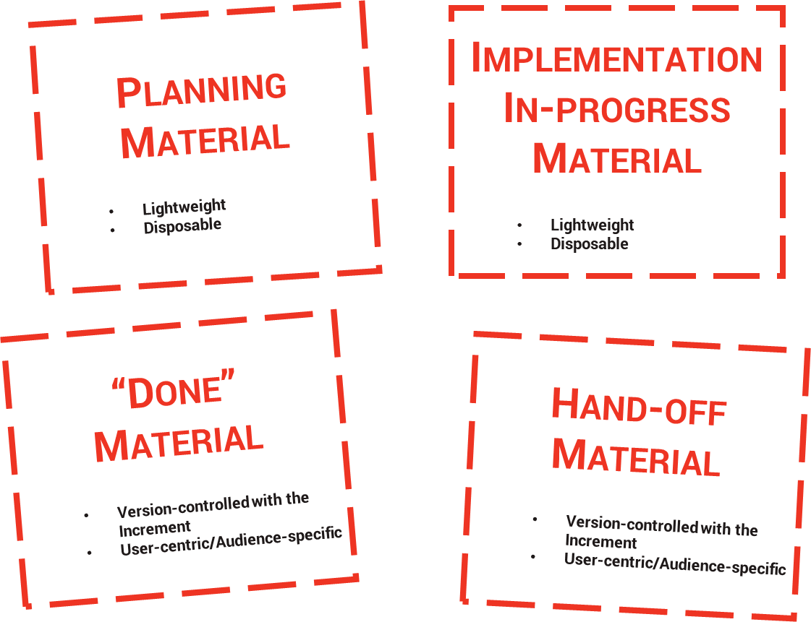
AFFINITY MAPPING
{~5 minutes}
Move stickies into appropriate quadrants based on whether they are:
Planning Docs
WIP Docs
“Done” Product Docs
Hand-off Docs
For each: destroy the sticky note if you cannot figure out a way to meet the quality criteria.
Notes:
3:26pm

Slide 20
CELEBRATE!
Notes:
3:38pm

Slide 21
DAVID SABINE
Get these documents at http://bit.ly/2qUPPAO
Notes:
3:40pm

